Slide 2
Quantifying the amount of excess noise due to residual phase noise in a CVQKD system
Hou-Man Chin, Ulrik Andersen, Tobias Gehring
DTU Physics

Slide 3
Introduction to CVQKD
Bob
public communication channels,
e.g., optical fiber links
Alice
…
ciphertexts
to Alice
…
ciphertexts
to Bob
Prior to the actual communication, can Alice and Bob also exchange the key over the public channel safely, i.e. prevent Eve from also knowing it?

Slide 4
Introduction to CVQKD
Information coded in continuous-variable (CV) properties, such as the amplitude and phase quadratures.
Coherent communication: Common phase reference using a local oscillator (LO).
CVQKD transmitter: Encode random bits by means of quadrature modulation.
CVQKD receiver: Decode using quadrature measurements (one or both simultaneously)
RNG
Variable
attenuator
LO
Tx laser
Quadrature
modulation
Sig
Sig
50/50
beamsplitter

Slide 5
CVQKD protocol
Alice
Bob
CVQKD
transmitter
Eve
CVQKD
receiver
LO
quantum channel
laser
laser
VATT
N exchanges (quantum states)
PC
50/50 BS
mod
Sig
State preparation
Information reconciliation
Parameter estimation
Privacy amplification
State measurement
Information reconciliation
Parameter estimation
Privacy amplification
authenticated (classical) channel
n symbols (uniform shared
randomness)
sk_{A}
sk_{B}
Application
m bits (secret key sk_{AB})
Application

Slide 6
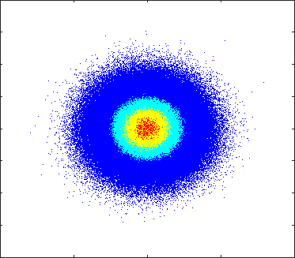
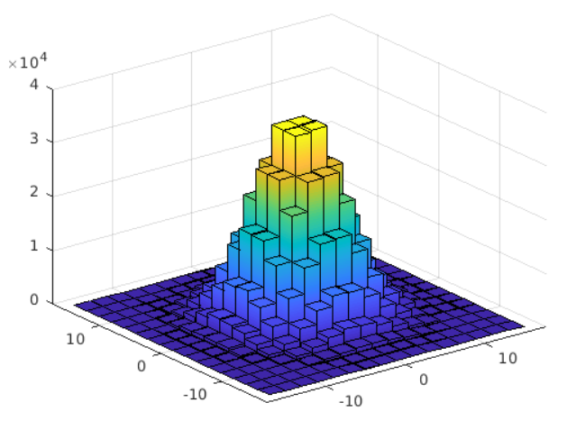
Continuous variable QKD
Encodes information onto continuous variables of light e.g. quadrature components
Compatibility with standard classical telecommunications electro-optic components e.g. we can use a standard IQ modulator
Coexistence with classical channels
Various methods of encoding, discrete [1], Gaussian [2], probabilistically shaped [3]
[1] Qu et al. Optics Letters, 41(23), 5507, 2016
[2] Jain et al. Nat. Comm., 13(1), 2021
[3] Roumestan et al. OFC 2022 Tu.3I.4
[3]
6

Slide 7
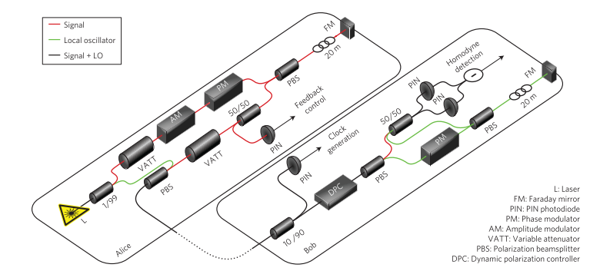
Transmitted LO CV-QKD systems
Jouguet et al. “Experimental demonstration of long-distance continuous-variable quantum key distribution,” Nature Photonics, 7(5), 378–381.
7

Slide 8
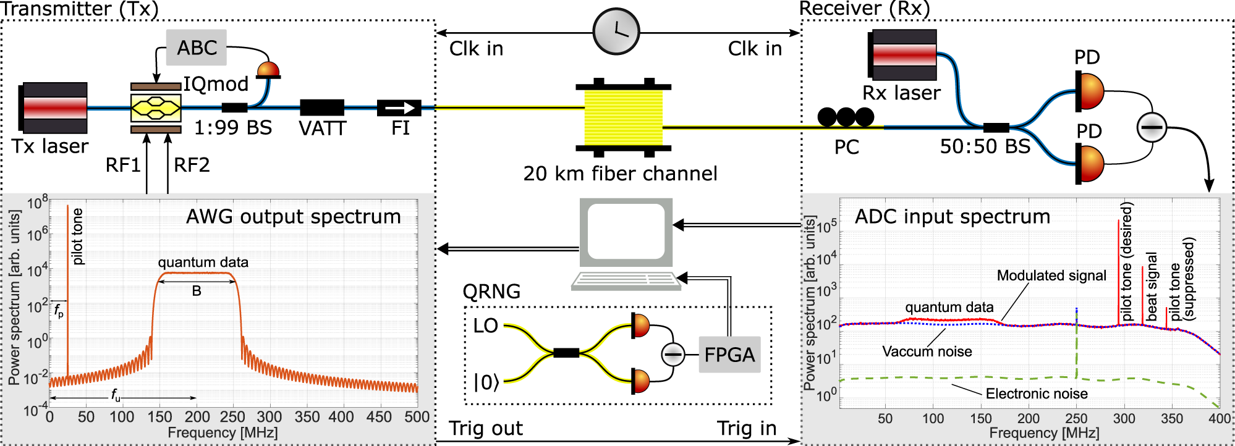
Local LO CV-QKD systems
Jain et al. “Practical continuous-variable quantum key distribution with composable security”. Nature Communications, 13(1), 2022
8

Slide 9
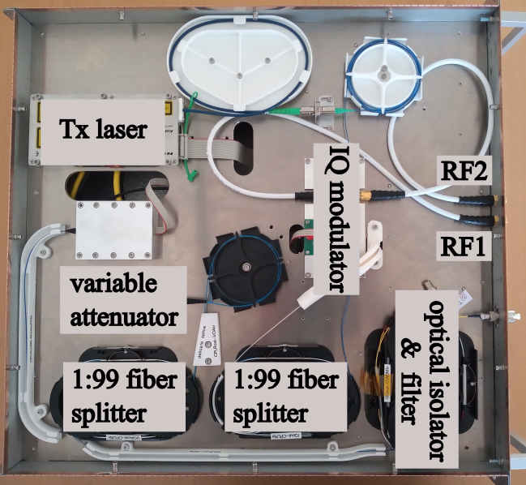
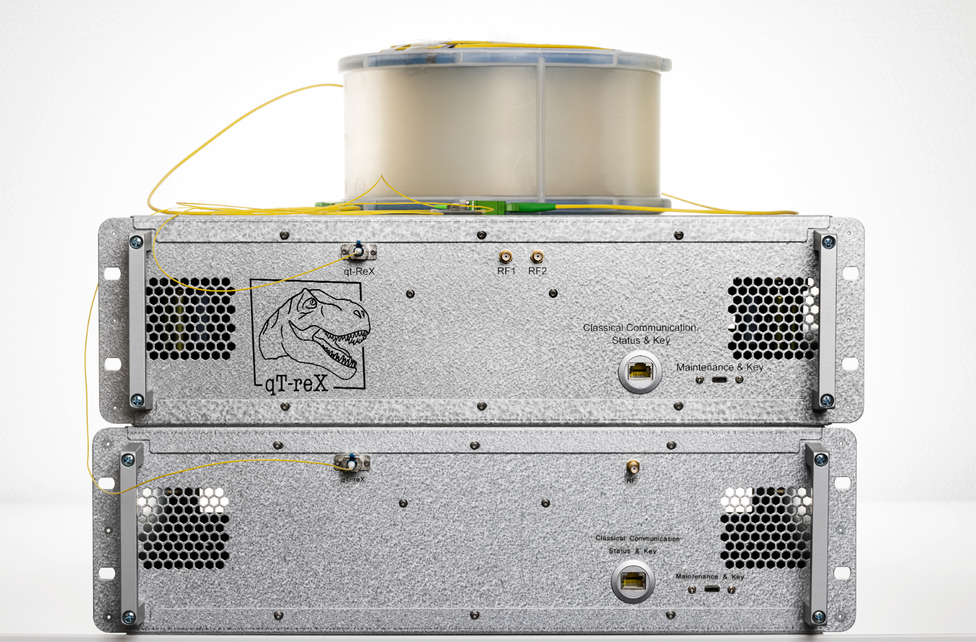
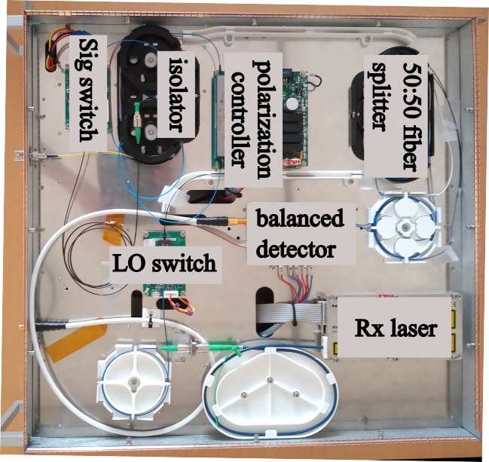
qTReX

Slide 10
Achieving security in QKD
$$Secret key rate= βI\left(A:B\right)− χ(B:E)$$
Reconciliation
efficiency
Mutual information
Holevo information
We can estimate the amount of information Eve has managed to obtain in a step known as parameter estimation using the estimated excess noise
Covariance between Alice and Bob
Excess noise
$\hat{ε}=\hat{y}−\frac{\hat{{\hat{z}}^{2}}}{N}−1$
Bob’s measured signal
Alice’s transmitted variance

Slide 11
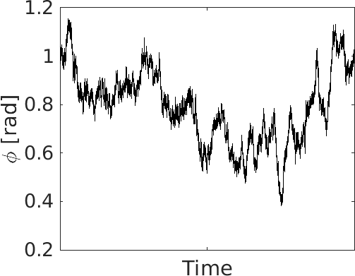
Phase noise
Carrier phase equalization
CV-QKD system with free running Tx and LO lasers
$\hat{ε}=\hat{y}−\frac{{\hat{z}}^{2}}{N}−1$
$$\hat{z}=\sqrt{\hat{η}N}$$
Includes DSP efficiency

Slide 12
So how bad is it, really?
Effect of residual phase calculated theoretically by [1]
$$ε_{phase}=2V_{A}(1−\exp^{{{−V}_{est}}/2})$$
Getting $V_{est}$ somewhat hard in LLO system, simulations performed far too well
FAKE IT
[1] A. Marie and R. Alleaume. Self-coherent phase reference sharing for continuous-variable quantum key distribution. Physical Review A, 95(1):1–22, 2017

Slide 13
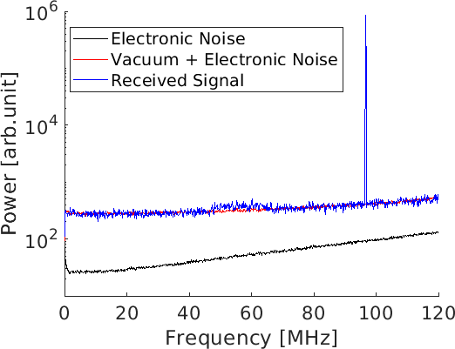
Experimental setup
TLO + modulated phase profiles allow for more controlled investigation
Apply an Unscented Kalman filter (UKF) for phase estimation on pilot tone and then compensation [1]
Apply inverse of modulated phase
Transmitted LO configuration
20 Mbaud QKD signal
[1] Chin et al. “Machine learning aided carrier recovery in continuous-variable quantum key distribution,” Npj Quantum Information, 7(1), 1–6.

Slide 14
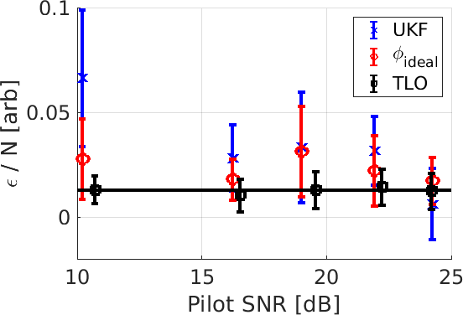
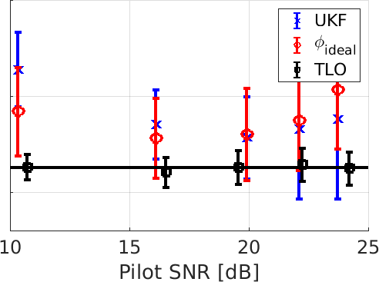
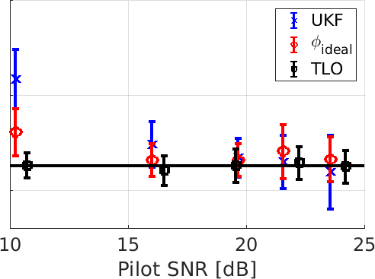
Experimental Results
10kHz Wiener
100kHz Wiener
Extracted Fibre Laser Phase
Pilot tone processed with a 3 MHz filter, SNR adjusted through the modulated RF power
Phase profiles generated using a 10 kHz and 100 kHz Wiener process and lastly extracted from two free running fibre lasers at very high power
Chin et al. “Towards optimum phase noise compensation for CV-QKD systems,” CLEO, 2023

Slide 15
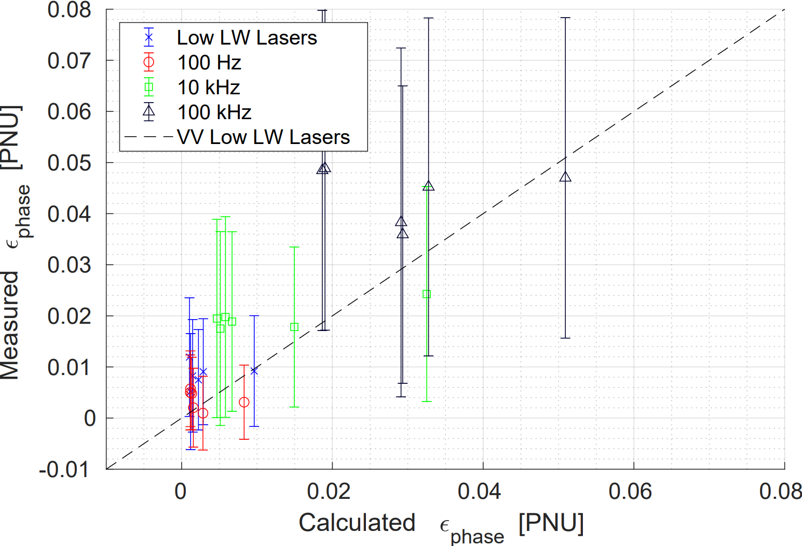
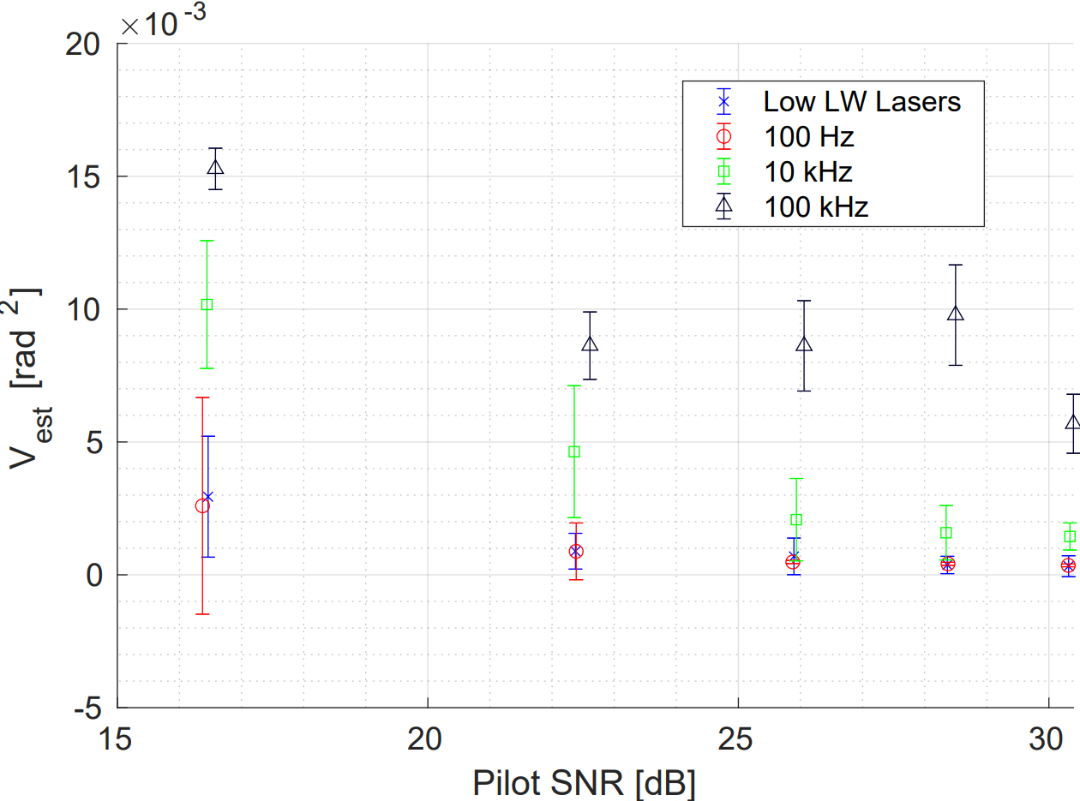
Experimental Results
B2B configuration
N = 3.4 PNU
Chin et al. “Experimental investigation of imperfect digital phase compensation in continuous variable quantum key distribution,” N/A, 2023

Slide 16
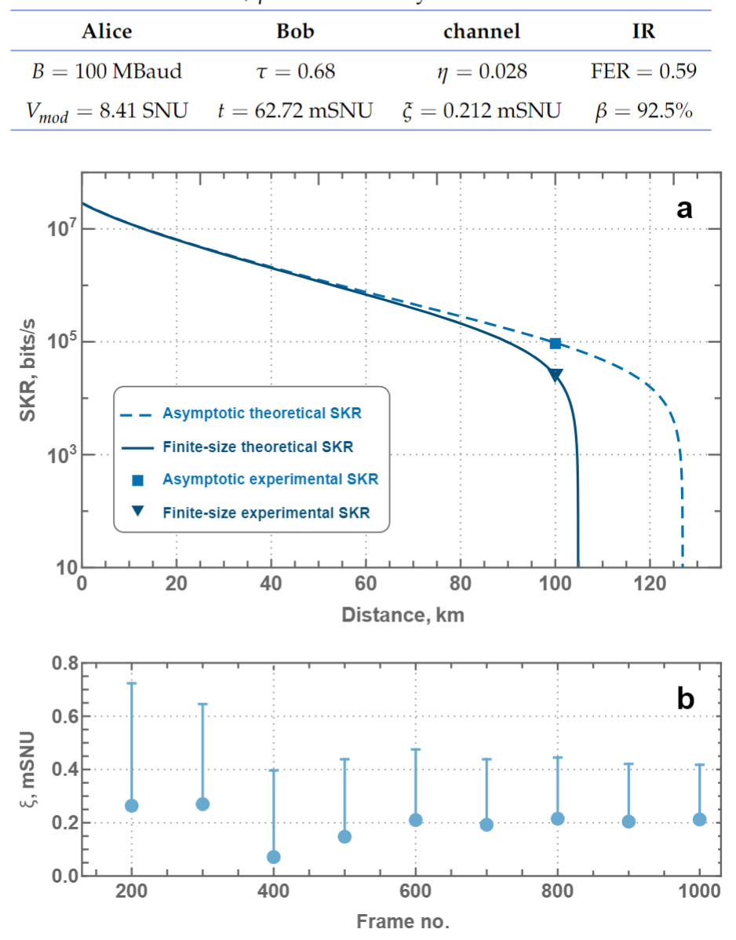
Corroborating results
Pilot SNR approx. 30 dB
$V_{est}=0.001$
Therefore
$$ε_{phase}=160 μSNU$$
$$ε_{phase}=2{TV}_{A}(1−\exp^{{{−V}_{est}}/2})$$
[1] Hajomer et al. “Long-distance continuous-variable quantum key distribution over 100 km fiber with local local oscillator,” arXiv:2305.08156

Slide 17
END

